Slide 1

Innolab 2021
Buenos Aires
JULY, 2021

Slide 2
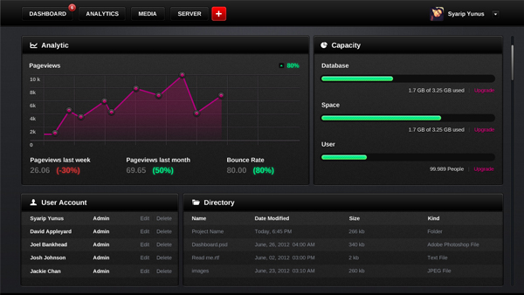
Power my-kpi

Slide 3
powerMykpi CONTEXT
powerMykpi approach
powerMykpi Roadmap
Demo
Q & a

Slide 4

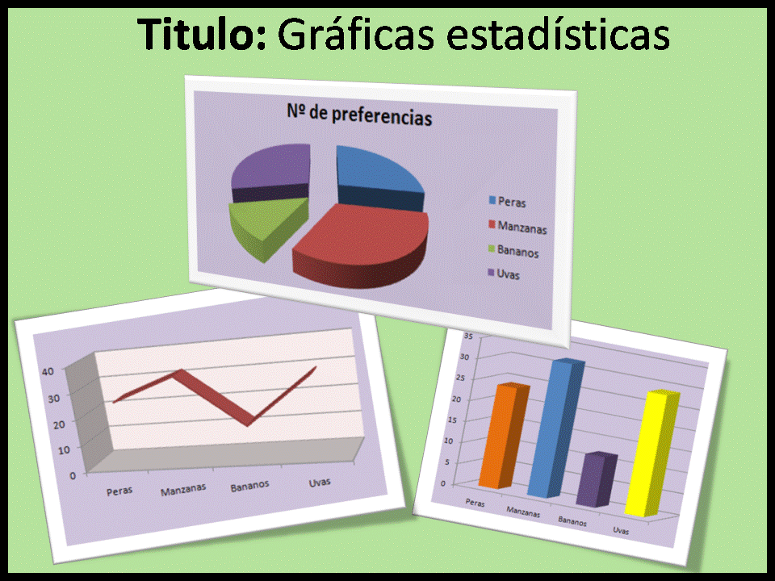
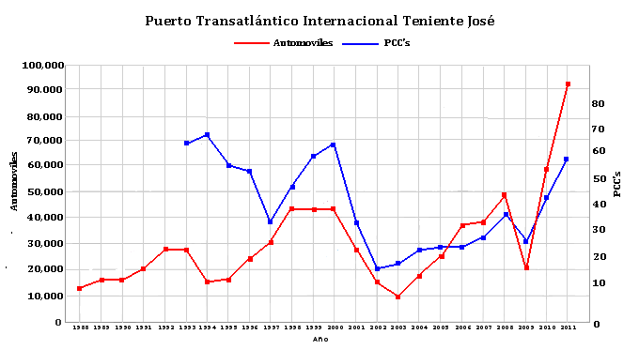
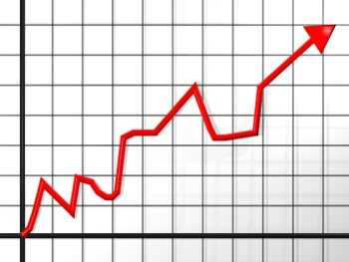
¿how we thought of this?
A menudo, Leticia, se encontraba en la necesidad de armar varios reports para diferentes destinatarios: Algunos necistaban información actualizada, otros, a una determinada fecha y otros, poder evaluar alguna tendencia (que requería información histórica pero calculada con una determinada periodicidad)

Slide 5
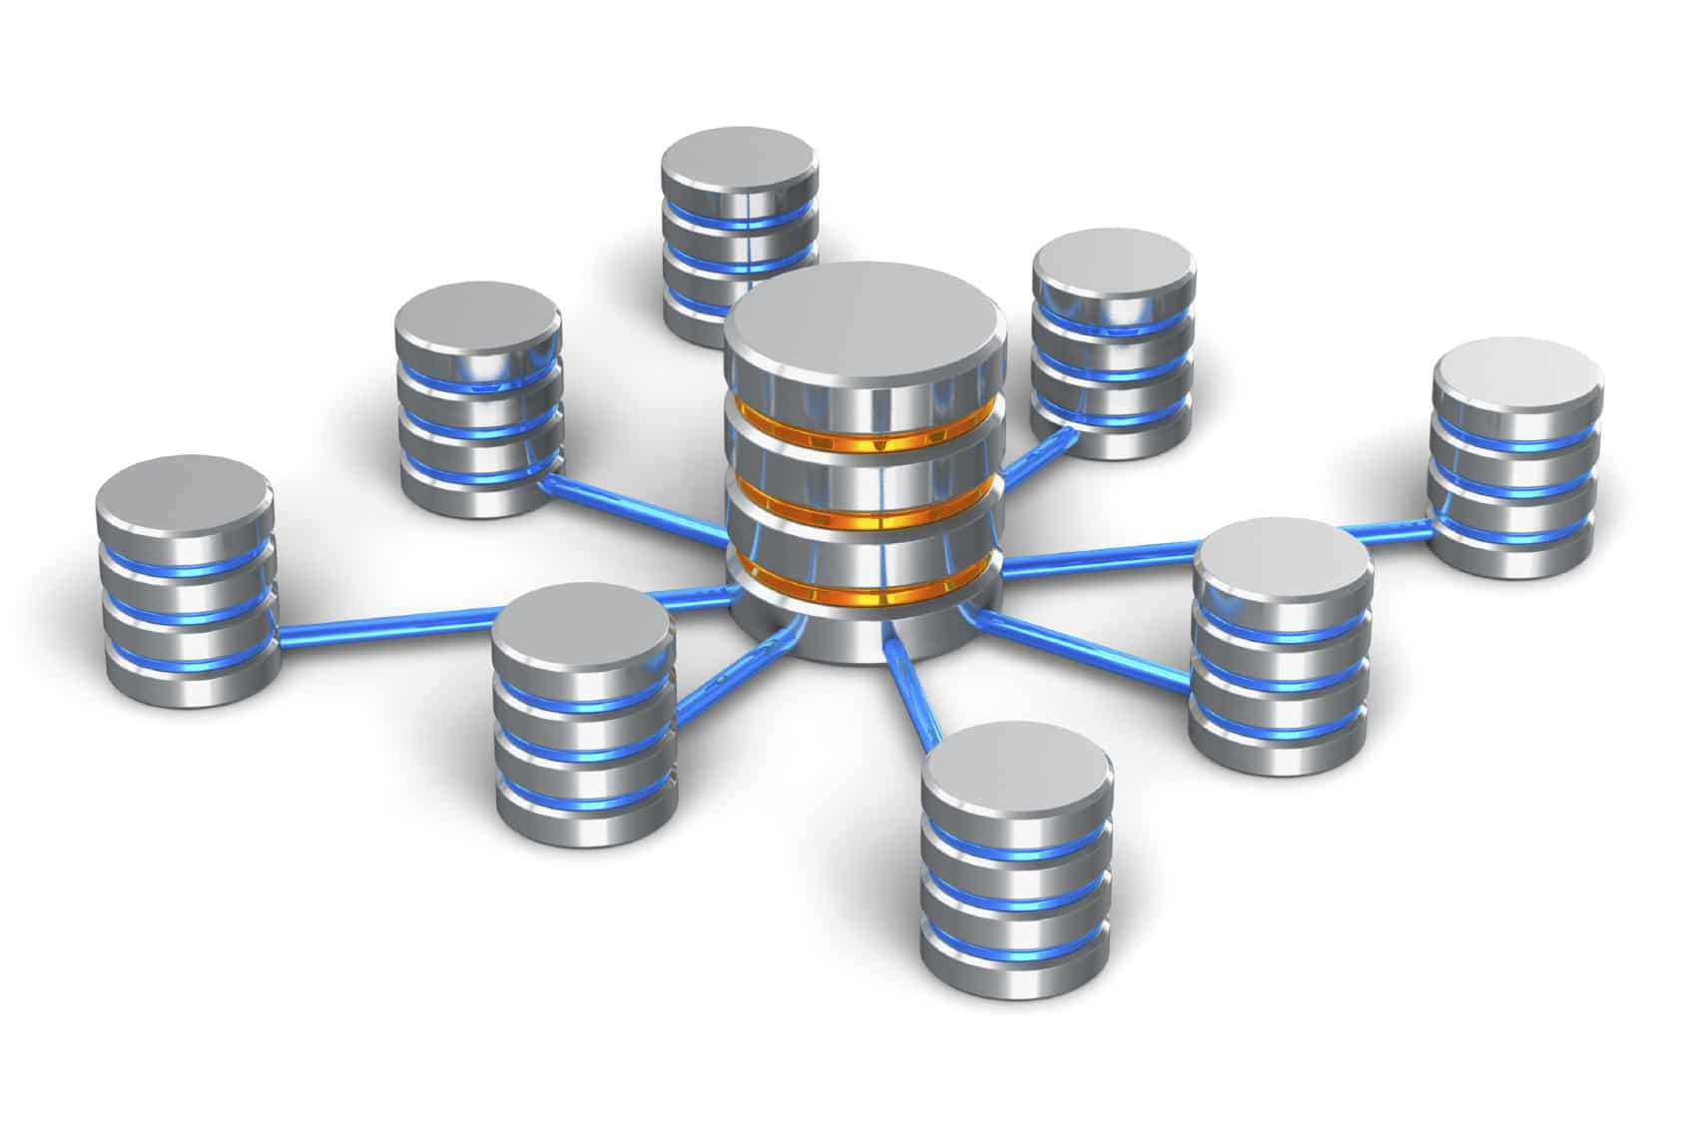



¿how did you mange to get around it?
Personal Reports
Assessments
Emails
Current data
Databases
+
Historical database with prediction capacity

Slide 6

As you can Imagine…
This is a hard boring task…

Slide 7

So….
One day she propose herself to findout if anything could be improved.

Slide 8
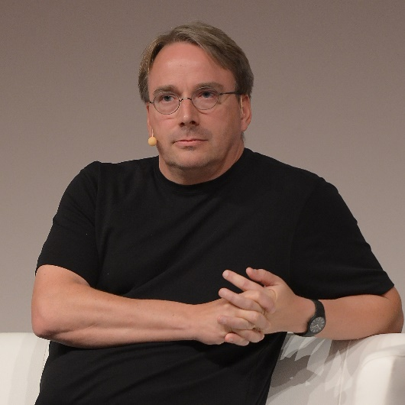


A couple of ideas appeared...
And she decided to share them with the IT guys to find out a better way

Slide 9
Powermykpi CONTEXT
powermykpi approach
powermykpi Roadmap
Demo
Q & a

Slide 10
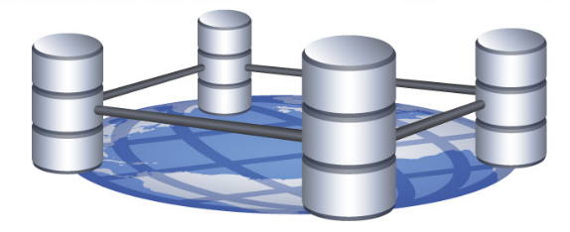
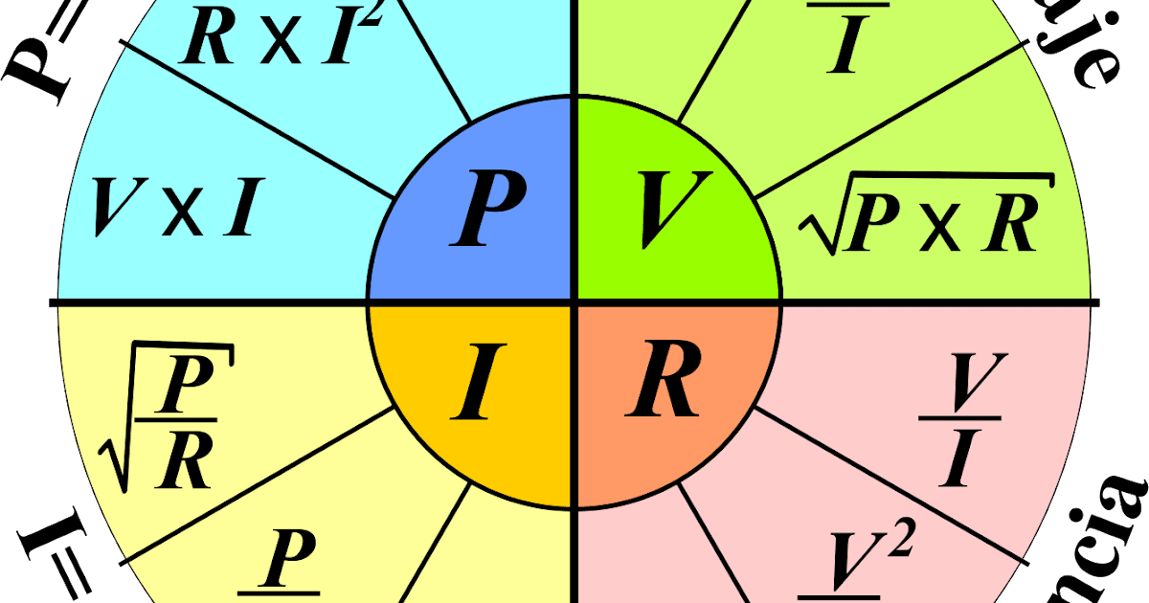




Power my kpi
Take different sources
Define different formulas por various indicators
Calculate and store the results automatically
Based con periodic historical information make predictions
Read data and generate reports automatically
Esta foto de Autor desconocido está bajo licencia CC BY-SA

Slide 11





CUSTOMERS of powermykpi
SALES
AGU
DELIVERY
QUALITY
MANAGEMENT
Getting Clients interested
Reassuring Clients
Shaping Proposals
RFx
Templates & Guidance
What to do? When?
ISO 9001, SOX
Auditors/Audits
Executive Reports
Differentiator, Maturity
An overview of TEAM and TEAS is included in the standard sales deck, this provides the initial structure and convinces the clients we have a mature and repeatable process
The content of TEAM provides the answers to SDLC questions in RFI/RFPs. The phases and roles defined in TEAM are used to structure the teams and engagement approach
There is a wealth of guidance on good practice in systems development, from how to ensure code quality to templates for the documents a client requests
TEAM is included in the scope of our quality management system and is assessed for appropriateness and utilisation by our auditors
The content of TEAM, particularly TEAS has been used as a differentiator to encourage investment in Endava

Slide 12
powerMykpi CONTEXT
powerMykpi approach
powerMykpi roadmap
Demo
Q & a

Slide 13
Power my kpi

Slide 14







scaled agile?
AGILE
Agile Scaled
ENTERPRISE AGILE
1-2 TEAMS
1 PO - SAME BL
Team & Product
2-7 TEAMS
1-3 POs, SAME BL, SAME PROG
Teams & Connected Products
8+ TEAMS , 3+ POs., SAME PORTFOLIO
MULTIPLE PROG
Unit & Product Ecosystem
Endava has built TEAS - Team Enterprise Agile Scaling, as a model of delivery based on the experience gained working with large product/project teams and programmes. TEAS designs the whole value flow, product-centric, from idea to production, enabling delivery from 1-2 teams, scaling up to 7 teams and going enterprise to more than 8 teams working on multiple programmes in the same portfolio.

Slide 15
powerMykpi CONTEXT
powermykpi approach
powerMykpi Roadmap
Demo
Q & a

Slide 16
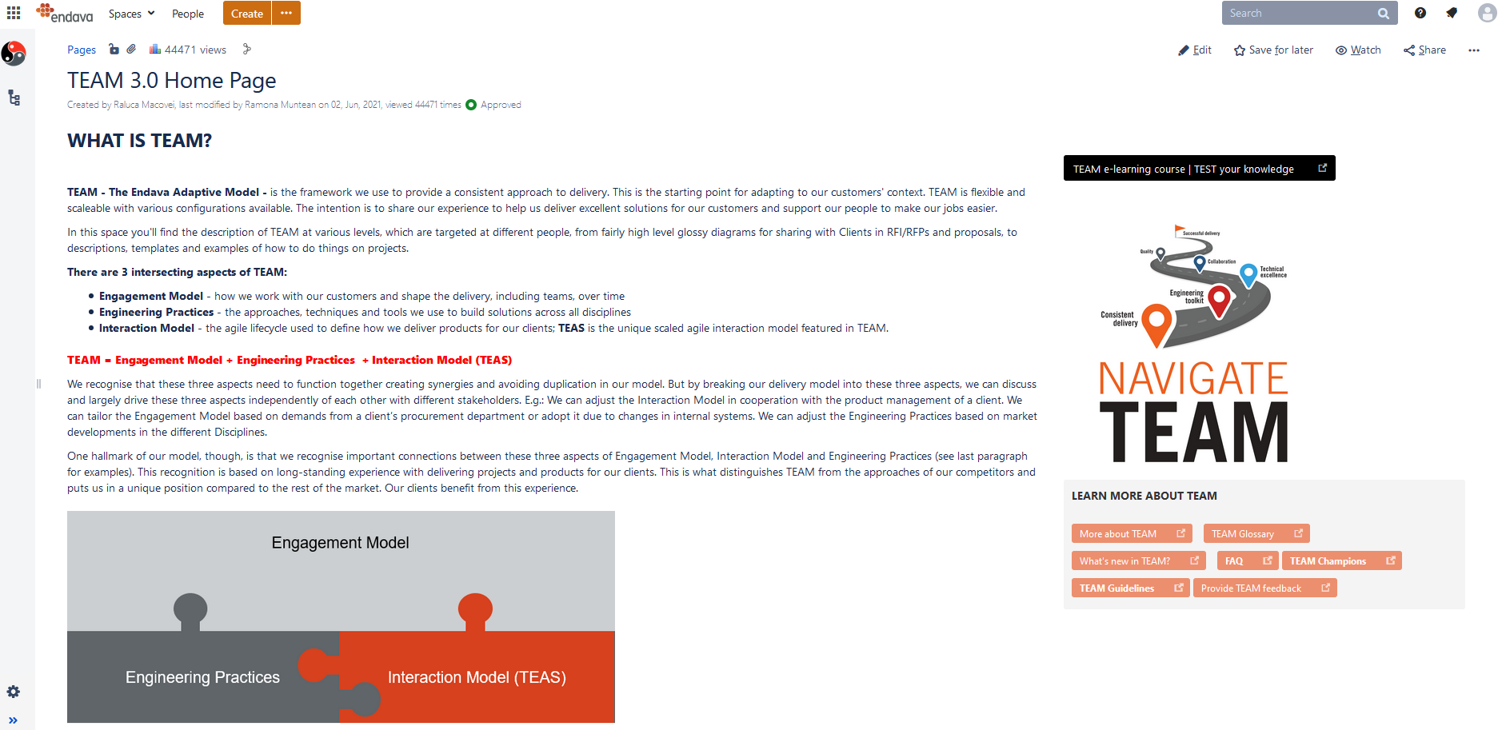
Powermykpi – Home page
powerMykpi.azurewebsites.net
Notes:
https://powermykpi.azurewebsites.net

Slide 17
powerMykpi CONTEXT
powerMykpi approach
powerMykpi roadmap
Demo
Q & a

Slide 18

THANK YOU!
powerMykpi
Innolab BAD 2021

